Slide 1
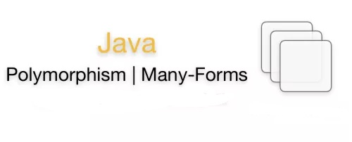

Slide 2
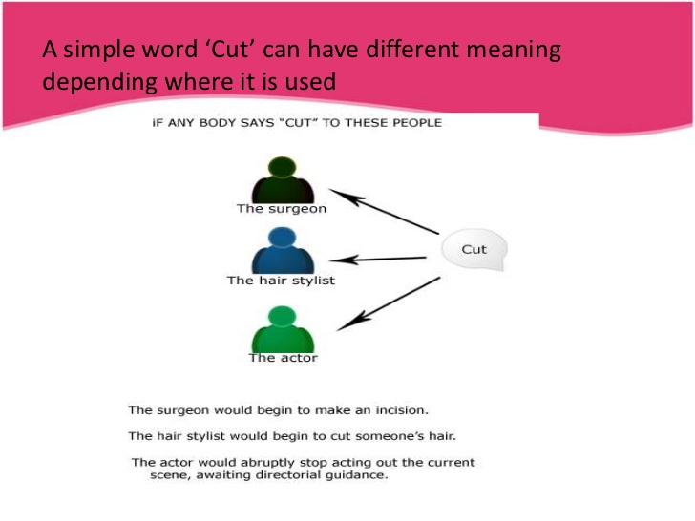
OOPS – Polymorphism
Polymorphism is the capability of a method to do different things based on the object that it is acting upon. In other words, polymorphism allows you define one interface and have multiple implementations

Slide 3
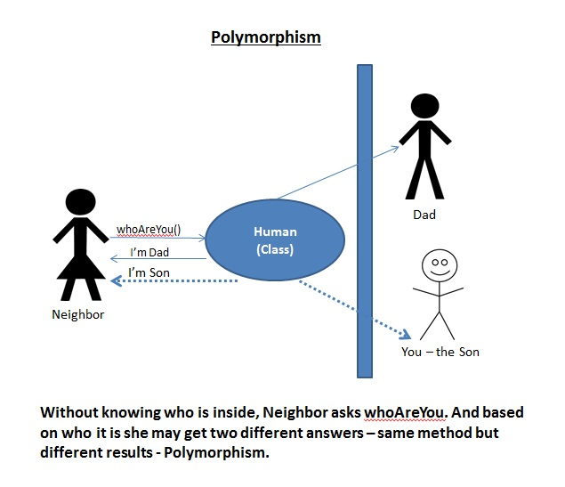
OOPS – Polymorphism

Slide 4
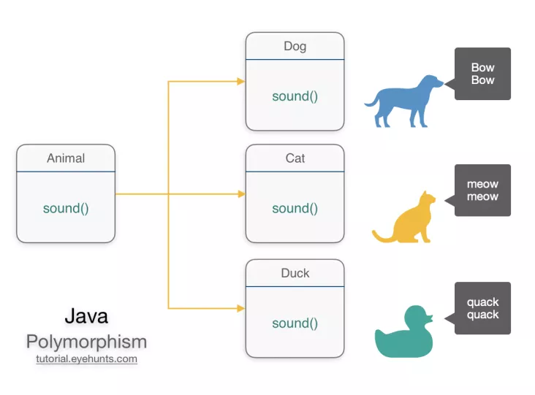
OOPS – Polymorphism
Polymorphism is one of the OOPs feature that allows us to perform a single action in different ways. For example, lets say we have a class Animal that has a method sound(). Since this is a generic class so we can’t give it a implementation like: Roar, Meow, Oink etc. We had to give a generic message.

Slide 5
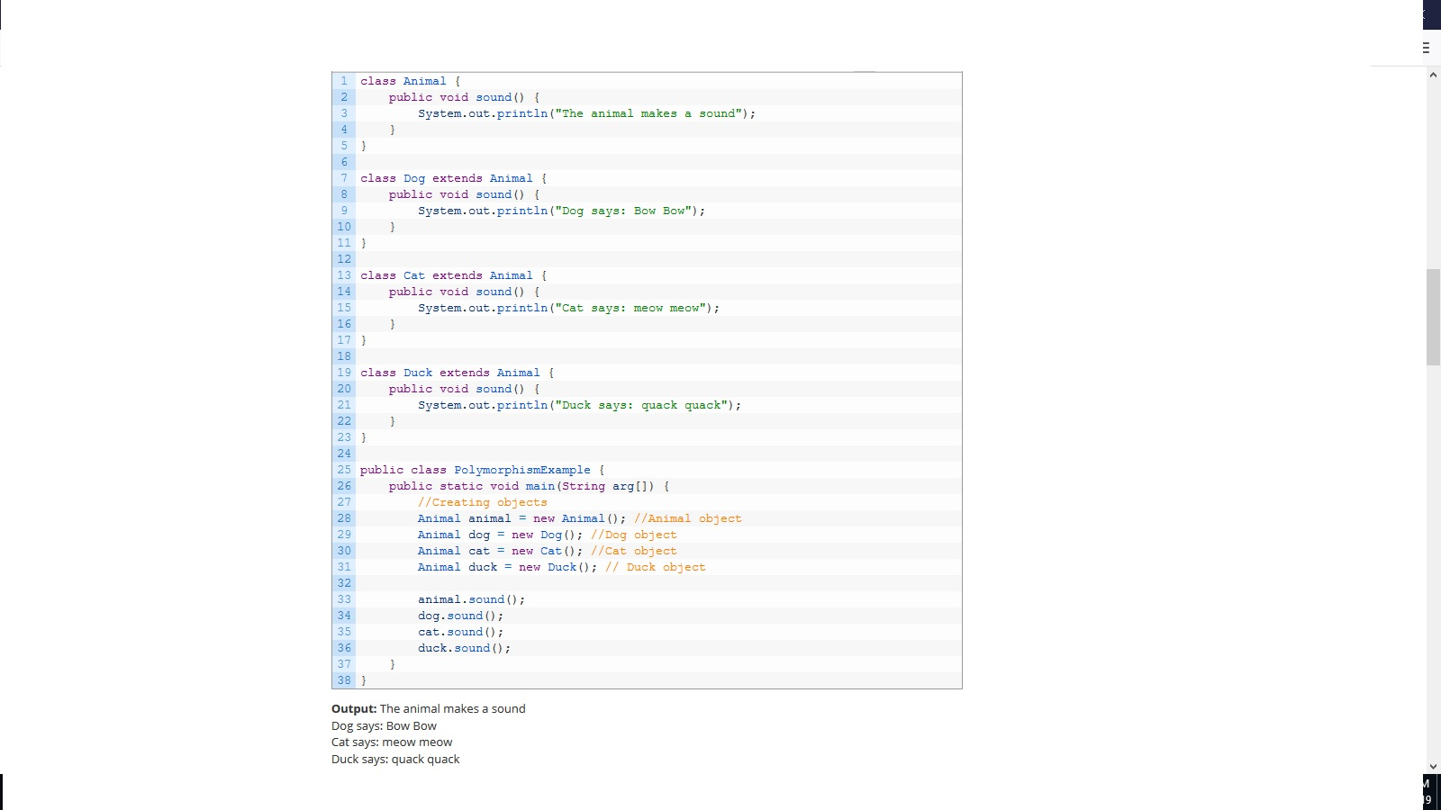
OOPS – Polymorphism

Slide 6
OOPS – Types Of Polymorphism
Types of Polymorphism
There are two types of polymorphism:
Compile time polymorphism
Run time polymorphism
Compile Time Polymorphism:
Whenever an object is bound with their functionality at compile time this is known as compile time polymorphism. At compile time, java knows which method to call by checking the method signatures. So this is called compile time polymorphism or static or early binding.
Implementation of Compile time polymorphism:
Compile time polymorphism is achieved through method overloading. Method Overloading says you can have more than one function with a same name in one class having a different prototype.
Run Time Polymorphism:
Whenever an object is bound with the functionality at run time, this is known as runtime polymorphism. You can have a method in subclass that overrides the method in its parent classes with the same name and parameters. Java virtual machine determines the proper method to call at the runtime, not at the compile time. It is also called dynamic or late binding.
Implementation of Run time polymorphism:
Run time or dynamic polymorphism is achieved(implemented) through method overriding. Method overriding says child class has the same method as declared in the parent class. It means if child class provides the specific implementation of the method that has been provided by one of its parent class then it is known as method overriding.

Slide 7
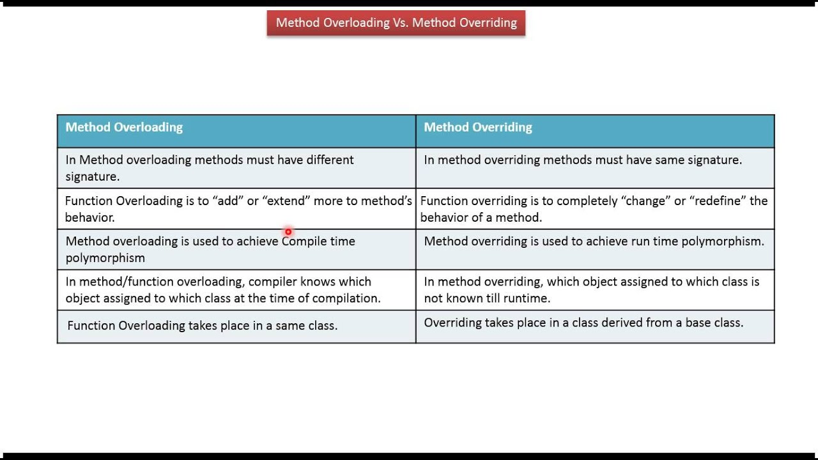

Slide 8
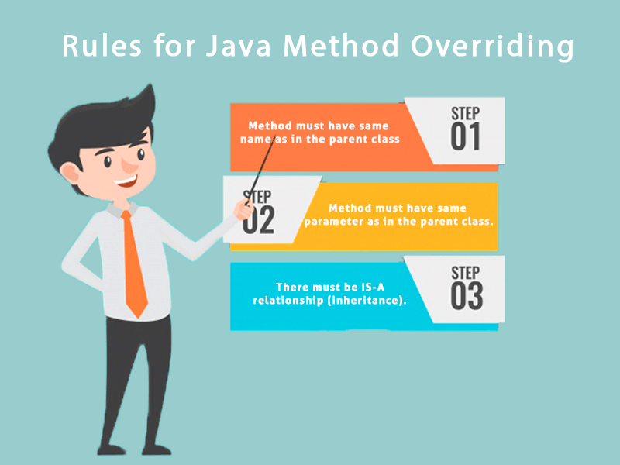
OOPS – Polymorphism - Overridding

Slide 9
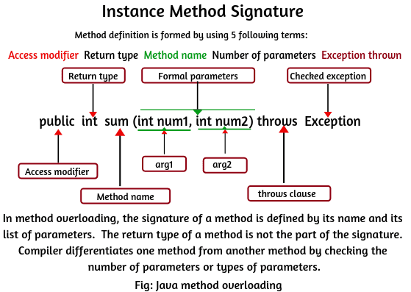
OOPS – Polymorphism - Overloading

Slide 10


